Slide 1



Restoration of Star-Field Images Using High-Level Languages and Core Libraries
Robin Bruce, Caroline Ruet, Dr Malachy Devlin, Prof Stephen Marshall

Slide 2
Overview
Introduction
MED – SA algorithm
ANSI C implementation
DIME-C implementation
Comparison software/hardware
Application
Conclusion & further work

Slide 3
Introduction
There is a need for objective research in reconfigurable computing (RC)
  Don’t just pick battles you know you’ll win
Need to evaluate effectiveness of RC as a general purpose solution
  How does it work on arbitrarily-selected problems?
There is a range of measures that we can apply to determine the performance improvement

Slide 4
Hardware Comparisons
Can Compare FPGAs to:
Digital Signal Processors (DSPs)
Application-Specific Integrated Circuits (ASICs)
Microprocessors
Other, could include
  Graphics Processing Units (GPUs)
  Cell BE Processor
  Clearspeed CX600

Slide 5
Hardware Comparisons II
Can compare with respect to:
  Raw performance
  Power consumption
  Unit cost
  Board footprint
  Non-Recurring Engineering Cost (NRE)
  Design time and Design cost
The key metrics for a particular application may also include ratios of these metrics, e.g. performance/power, or performance/unit cost.

Slide 6
Application Choice
Implementation of the Minimum Entropy Deconvolution algorithm using Simulated Annealing method: representative of a computationally intense image-processing application
Chosen Fairly Arbitrarily
  Only knew that it was a compute-intensive algorithm
  Did not know how suitable the algorithm was for implementation on RCs before committing to it

Slide 7
Chosen Comparison
Comparing a 90nm-process commodity microprocessor with a platform based around a 90nm-process FPGA
  3.2 GHz Intel Pentium D processor with 2 GB of DRAM, with the gcc compiler
  Nallatech H101-PCIXM card, with the DIME-C compiler
    Xilinx Virtex-4 LX160 FPGA, 512 MB of DRAM and 4 banks of 200MHz, 4 MB SRAM.
Focussing on design time and raw performance improvement.

Slide 8
MED – SA algorithm
Restore blurred images
MED algorithm with SA used to converge towards the globally-optimum solution
y = x ٭ h + n
  y: observed image, x: original image, h: Gaussian filter, n: white Gaussian noise
Estimate x from y
Computation of 2 gradients: Δx=∂E/∂x, Δd=∂E/∂d
*
=
Estimated image
Estimated filter
Observed image

Slide 9
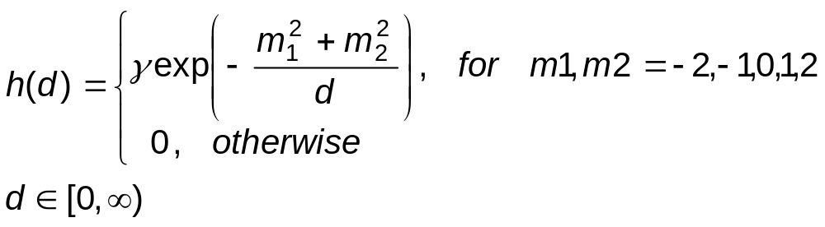
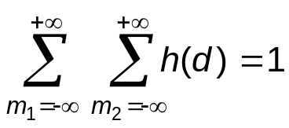
MED – SA algorithm
Assumptions
  PSF is a Gaussian function
  m1, m2 designates the size of the PSF
  d corresponds to the width of the PSF (blurring level)
  γ is a constant to normalise the Gaussian function:

Slide 10
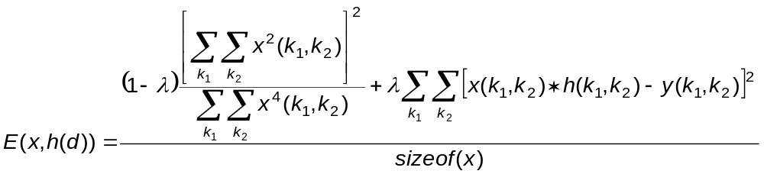
MED – SA algorithm
Algorithm – minimising the Energy E
  Step 0: Set p=0 and initialise x_{p}, T_{p}, d_{p} and α, β, λ
  Step 1: Compute the energy E_{p}(x_{p}, h(d_{p}))

Slide 11
MED – SA algorithm
  Step 2: Select a candidate solution
  x’_{p+1} = x_{p} - αΔx_{p}
  d’_{p+1} = d_{p} - βΔd_{p}

Slide 12
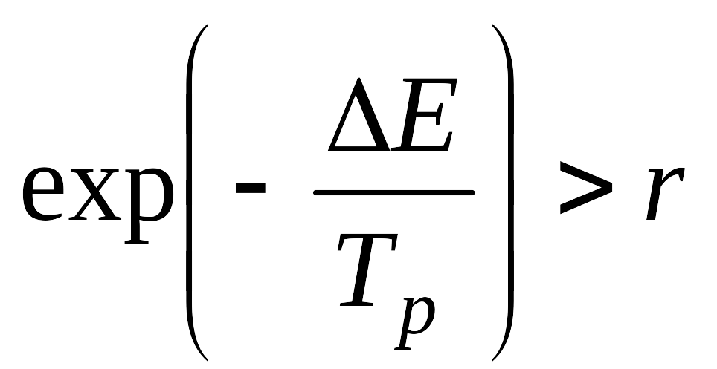
MED – SA algorithm
  Step 3: Compute the energy E’_{p+1}(x’_{p+1}, h(d’_{p+1}))
  ΔE = E’_{p+1} - E_{p}
  Step 4:
  If: where r is a random number Є [0,1]
  Then:
  Else:
  where f(.) is a decreasing function
  Step 5: p = p + 1, #_iterations = #_iterations – 1
  Step 6: Output xp+1 is the estimation image

Slide 13
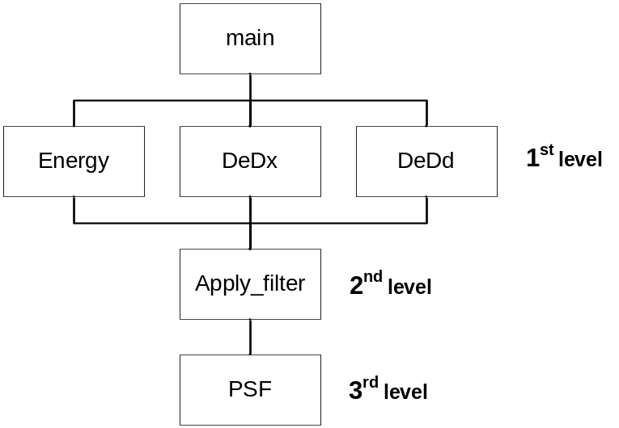
ANSI C Implementation
Algorithm organisation
The C program is not initially optimised
Functional Hierarchy

Slide 14
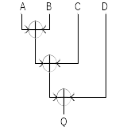
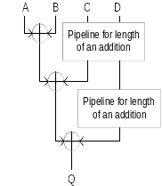

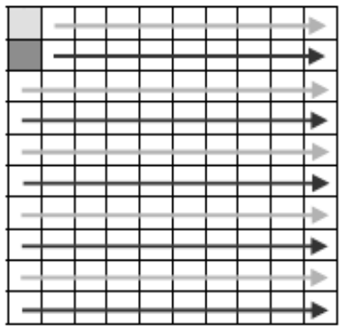
DIME-C Implementation
Code modification
Loop Fusion
Pipelining
Spatial parallelism
Resource optimisation
Pipelining
Spatial parallelism
5/9

Slide 15
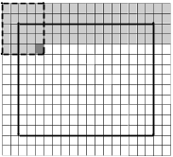
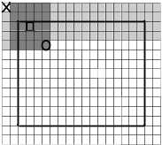






Example Optimisation
Filter Application
  number of cycles: ≈ 480,111
  (before optimisation: 12,000,133)
  number of slices: = 27733
  (before optimisation: 3184)
Graphical representations of the filter implementation

Slide 16
Core Libraries
Made use of single-precision mathematical operators that are integrated into DIME-C
Project depended on random number generator and exponential function
  Not in compute intensive region of algorithm
  Functions acted as an enabler to full algorithm implementation
Hear more about Core Libraries from me later today

Slide 17
Implementation Procedure
1. Created a DIME-C project using the original source from the ANSI C project
2. Adapted source to allow compilation in both DIME-C and ANSI C environments
3. Took advantage of the most obvious pipelining opportunities to create 1st FPGA implementation
4. Examining the source code and the output of DIME-C, created an equation that expressed the runtime of the algorithm in cycles, as a function of the parameters of the algorithm, divided into key sections.
5. Determined for a typical set of algorithm parameters the section that took up the majority of the runtime, and optimised the DIME-C for this section to create the 2nd FPGA implementation
6. Repeated sections 4&5 to produce the 3rd FPGA implementation,

Slide 18
Time to Solution
Developing the initial ANSI C Implementation
  125 Person Hours
Developing the DIME-C Implementation
  35 Person Hours
Most time spent developing the software

Slide 19
Software versus Hardware
Several generations of the FPGA implementation compared to software
DeDx remains the focus of a 5th version
 | Software | 1st FPGA | 2nd FPGA | 3rd FPGA | 4th FPGA
Cycles |  | 7.98×10¹⁰ | 8.72×10¹⁰ | 4.30×10¹⁰ | 2.59×10¹⁰
Time in Seconds | 216 | 798.00 | 87.24 | 42.96 | 25.92
Speedup vs. Software | 1 | 0.27 | 2.48 | 5.03 | 8.33
% Contribution of:
De_Dx |  | 5.02 | 45.94 | 93.29 | 88.91
Filter |  | 94.74 | 51.86 | 2.24 | 3.71
Rest of Algorithm |  | 0.24 | 2.20 | 4.47 | 7.38

Slide 20


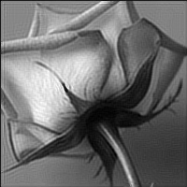
Example Results
Simulation of real Black and White pictures
  200 x 200 image
  7 x 7 filter
Original image
Observed image:
blurred and noisy
Restored image
300 iterations

Slide 21
Conclusion
Good performance: speedup ≈ 8
Design productivity was high using DIME-C
Increased performance and productivity possible using libraries of low-level IP cores
100-Page report available for those who want to know more

Slide 22

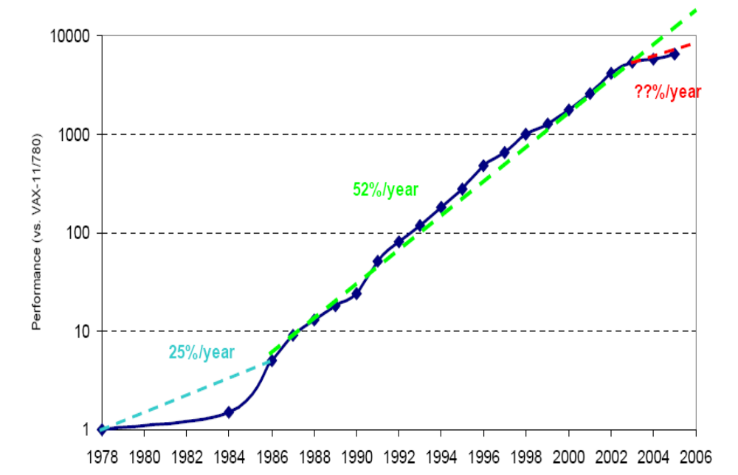
Microprocessor Speedups

Slide 23
Speedup in Context
Moore’s Law Tells us Performance Doubles Every 18 months
  Does it really?
Hennessey & Patterson (2007) tell us that processor performance improved by 52% a year until 2002.
Since 2002 it’s been running at around 20% a year

Slide 24
Speedup in Context II
If an FPGA gives you an 8x speedup now, how many years would it take for the microprocessor to catch up?
Assumption Alert!
  Benchmark used to evaluate processors gives a good idea of how our application would perform
  Comparing two best-effort implementations on the same process node, FPGA and uP
8x Speedup would take 11-12 years to attain at 20% per annum improvements

Slide 25
The Magic Numbers
How much is being 12 years ahead of the competition worth?
Reconfigurable Computing must offer (insert magic number) X improvement over conventional computing to see widespread adoption
  Such a blanket statement is meaningless
Depends on the economics of the application

Slide 26
Acknowledgements
Research is sponsored by Nallatech
Institute for System Level Integration made everything possible
Caroline did all the hard work

Slide 27
Quote
Alan Perlis - When someone says "I want a programming language in which I need only say what I wish done," give him a lollipop.

